Slide 1
JavaScript Maps
A Map Holds Key-value pairs where the keys can be any datatype.
A Map remembers the Original Insertion Order of the Keys.
Essential Map Methods
Method | Description
new Map() | Creates a new Map
set() | Sets the value for a key in a Map
get() | Gets the value for a key in a Map
delete() | Removes a Map element specified by the key
has() | Returns true if a key exists in a Map
forEach() | Calls a function for each key/value pair in a Map
entries() | Returns an iterator with the [key, value] pairs in a Map

Slide 2
Features of Javascript map function
Javascript array has lots of features and built-in methods which are ready to use, the map method is one of them. Here are some of the features of the Javascript map method.
It transforms the elements of the source array and returns a new array by applying callback function on each item of an array.
It is a higher-order function, and the return type is implicit, especially when we have one statement in the map function.
The size of the new return array is the same as the original or source array.
An index is optional, no need to add it if you don’t need it in a callback function.

Slide 3
How to Create a Map
The set() Method
// Create a Map const fruits = new Map(); // Set Map Values fruits.set("apples", 500); fruits.set("bananas", 300); fruits.set("oranges", 200);
You can create a JavaScript Map by:
Passing an Array to new Map()
Create a Map and use Map.set()
The new Map() Method
Const students=new Map([
[“ABC”,111],
[“BCD”112],
[“CDE”,113]
]);

Slide 4
Regular Expressions
A regular expression is a sequence of characters that forms a search pattern.
The search pattern can be used for text search and text replace operations.
What Is a Regular Expression?
A regular expression is a sequence of characters that forms a search pattern.
When you search for data in a text, you can use this search pattern to describe what you are searching for.
A regular expression can be a single character, or a more complicated pattern.
Regular expressions can be used to perform all types of text search and text replace operations.

Slide 5
Regular Expression Patterns
Quantifiers define quantities:
Brackets are used to find a range of characters:
Metacharacters are characters with a special meaning:
Expression | Description
[abc] | Find any of the characters between the brackets
[0-9] | Find any of the digits between the brackets
(x|y) | Find any of the alternatives separated with |
Quantifier | Description
n+ | Matches any string that contains at least one n
n* | Matches any string that contains zero or more occurrences of n
n? | Matches any string that contains zero or one occurrences of n
Metacharacter | Description
\d | Find a digit
\s | Find a whitespace character
\b | Find a match at the beginning of a word like this: \bWORD, or at the end of a word like this: WORD\b
\uxxxx | Find the Unicode character specified by the hexadecimal number xxxx

Slide 6
Errors & Exceptions Handling
There are three types of errors in programming:
(a) Syntax Errors,
(b) Runtime Errors,
(c) Logical Errors
Syntax Errors:-Syntax errors, also called parsing errors, occur at compile time in traditional programming languages and at interpret time in JavaScript.
For example, the following line causes a syntax error because it is missing a closing parenthesis.
<script type = "text/javascript"> window.print(; </script>

Slide 7
Runtime Errors
Runtime Errors:-Runtime errors, also called exceptions, occur during execution (after compilation/interpretation).
For example, the following line causes a runtime error because here the syntax is correct, but at runtime, it is trying to call a method that does not exist.
<script type = "text/javascript">
window.printme();
</script>

Slide 8
Logical Errors
Logic errors can be the most difficult type of errors to track down. These errors are not the result of a syntax or runtime error. Instead, they occur when you make a mistake in the logic that drives your script and you do not get the result you expected.
You cannot catch those errors, because it depends on your business requirement what type of logic you want to put in your program.

Slide 9
The try...catch...finally Statement
The latest versions of JavaScript added exception handling capabilities. JavaScript implements the try...catch...finally construct as well as the throw operator to handle exceptions.
You can catch programmer-generated and runtime exceptions, but you cannot catch JavaScript syntax errors.
The try block must be followed by either exactly one catch block or one finally block (or one of both). When an exception occurs in the try block, the exception is placed in e and the catch block is executed. The optional finally block executes unconditionally after try/catch.
The throw Statement:-You can use throw statement to raise your built-in exceptions or your customized exceptions. Later these exceptions can be captured and you can take an appropriate action.
<script >
<!-- try { // Code to run [break;] }
catch ( e ) { // Code to run if an exception occurs [break;] }
[ finally { // Code that is always executed regardless of // an exception occurring }] //-->
</script>

Slide 10
This Keyword
In JavaScript, the this Keyword Refers to an object.
Which object depends on how this is being invoked (used or called).
The this keyword refers to different objects depending on how it is used:
In an object method, this refers to the object.
Alone, this refers to the global object.
In a function, this refers to the global object.
In a function, in strict mode, this is undefined.
In an event, this refers to the element that received the event.
Methods like call(), apply(), and bind() can refer this to any object.

Slide 11
This Keyword
this in a Method
When used in an object method, this refers to the object.
this Alone
When used alone, this refers to global object.
this in a Function (Default)
In a function, the global object is the default binding for
function myFunction() { return this; }
fullName : function() { return this.firstName + " " + this.lastName; }
let x = this;

Slide 12
This Precedence
To determine which object this refers to; use the following precedence of oreder.
Precedence | Object
1 | bind()
2 | apply() and call()
3 | Object method
4 | Global scope
Is this in a function being called using bind()?
Is this in a function being called using apply()?
Is this in a function being called using call()?
Is this in an object function (method)?
Is this in a function in the global scope.

Slide 13
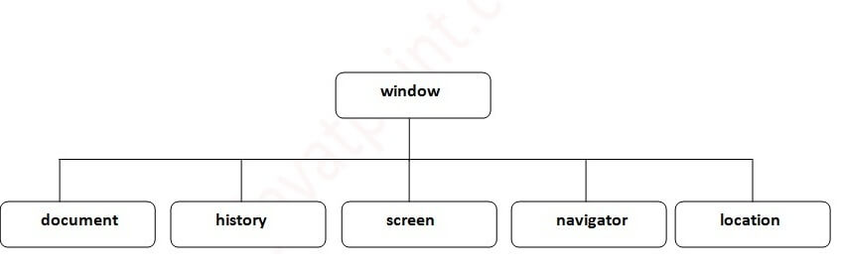
Browser Object Model
The Browser Object Model (BOM) is used to interact with the browser.
The default object of browser is window means you can call all the functions of window by specifying window or directly.

Slide 14
Window Object
The window object represents a window in browser. An object of window is created automatically by the browser.
Window is the object of browser, it is not the object of javascript. The javascript objects are string, array, date etc.
Methods of window object
The important methods of window object are as follows:
Method | Description
alert() | displays the alert box containing message with ok button.
confirm() | displays the confirm dialog box containing message with ok and cancel button.
prompt() | displays a dialog box to get input from the user.
open() | opens the new window.
close() | closes the current window.
setTimeout() | performs action after specified time like calling function, evaluating expressions etc.

Slide 15
JavaScript History Object
The JavaScript history object represents an array of URLs visited by the user. By using this object, you can load previous, forward or any particular page.
The history object is the window property, so it can be accessed by:
Window.history or
history
Example of history object
history.back();//for previous page
history.forward();//for next page
history.go(2);//for next 2nd page
history.go(-2);//for previous 2nd page

Slide 16
JavaScript Navigator and Screen Object
The JavaScript navigator object is used for browser detection. It can be used to get browser information such as appName, appCodeName, userAgent etc.
The navigator object is the window property, so it can be accessed by:
window.navigator Or,
navigator
The JavaScript screen object holds information of browser screen. It can be used to display screen width, height, colorDepth, pixelDepth etc.
The navigator object is the window property, so it can be accessed by:
window.screen Or,
screen

Slide 17
Document Object Model
document object represents the whole html document.
When html document is loaded in the browser, it becomes a document object. It is the root element that represents the html document. It has properties and methods. By the help of document object, we can add dynamic content to our web page.
As mentioned earlier, it is the object of window. So
window.document or
document

Slide 18
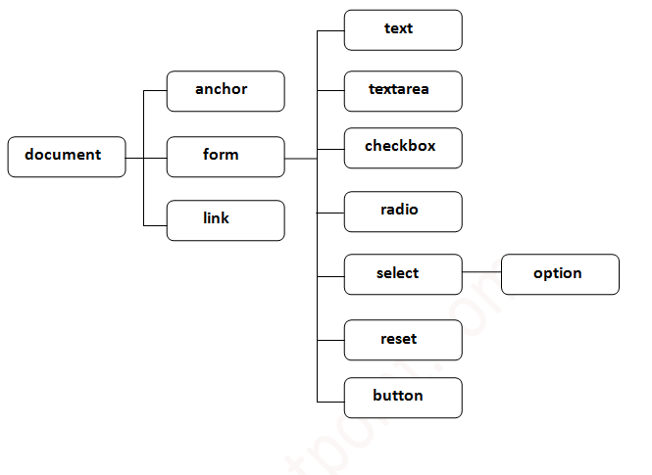
Properties of document object
Method | Description
write("string") | writes the given string on the doucment.
writeln("string") | writes the given string on the doucment with newline character at the end.
getElementById() | returns the element having the given id value.
getElementsByName() | returns all the elements having the given name value.
getElementsByTagName() | returns all the elements having the given tag name.
getElementsByClassName() | returns all the elements having the given class name.

Slide 19
JavaScript Async

Slide 20
Callbacks
"I will call back later!"
A callback is a function passed as an argument to another function
This technique allows a function to call another function
A callback function can run after another function has finished
When to Use a Callback?
Where callbacks really shine are in asynchronous functions, where one function has to wait for another function (like waiting for a file to load).

Slide 21
Asynchronous
Asynchronous is a non-blocking architecture, so the execution of one task isn’t dependent on another. Tasks can run simultaneously.
In Simple Words
“I will finish later!"
Functions running in parallel with other functions are called asynchronous
A good example is JavaScript setTimeout()

Slide 22
When to use async programming
Asynchronous programming should only be used in programming independent tasks, where it plays a critical role.
For instance, asynchronous programs are ideal for development projects with a large number of iterations. Because steps don’t have to follow a fixed sequence, asynchronous programming will keep development moving forward.
Responsive UI is a great use case for asynchronous planning. Take, for example, a shopping app. When a user pulls up their order, the font size should increase. Instead of first waiting to load the history and update the font size, asynchronous programming can make both actions happen simultaneously.

Slide 23
Promises
"I Promise a Result!"
"Producing code" is code that can take some time
"Consuming code" is code that must wait for the result
A Promise is a JavaScript object that links producing code and consuming code
Syntax
let myPromise = new Promise(function(myResolve, myReject) { // "Producing Code" (May take some time) myResolve(); // when successful myReject(); // when error }); // "Consuming Code" (Must wait for a fulfilled Promise) myPromise.then( function(value) { /* code if successful */ }, function(error) { /* code if some error */ }

Slide 24
Promise Object Properties
A JavaScript Promise object can be:
Pending
Fulfilled
Rejected
The Promise object supports two properties: state and result.
While a Promise object is "pending" (working), the result is undefined.
When a Promise object is "fulfilled", the result is a value.
When a Promise object is "rejected", the result is an error object.
myPromise.state | myPromise.result
"pending" | undefined
"fulfilled" | a result value
"rejected" | an error object

Slide 25
Async
"async and await make promises easier to write"
async makes a function return a Promise
await makes a function wait for a Promise

Slide 26
JQuery

Slide 27
What is jQuery
jQuery is a fast, small, and feature-rich JavaScript library. It makes things like HTML document traversal and manipulation, event handling, animation, and Ajax much simpler with an easy-to-use API that works across a multitude of browsers.
jQuery makes a web developer's life easy. It provides many built-in functions using which you can accomplish various tasks easily and quickly.

Slide 28
jQuery Important Features
DOM Selection: jQuery provides Selectors to retrieve DOM element based on different criteria like tag name, id, css class name, attribute name, value, nth child in hierarchy etc.
DOM Manipulation: You can manipulate DOM elements using various built-in jQuery functions. For example, adding or removing elements, modifying html content, css class etc.
Special Effects: You can apply special effects to DOM elements like show or hide elements, fade-in or fade-out of visibility, sliding effect, animation etc.
Events: jQuery library includes functions which are equivalent to DOM events like click, dblclick, mouseenter, mouseleave, blur, keyup, keydown etc. These functions automatically handle cross-browser issues.
Ajax: jQuery also includes easy to use AJAX functions to load data from servers without reloading whole page.
Cross-browser support: jQuery library automatically handles cross-browser issues, so the user does not have to worry about it. jQuery supports IE 6.0+, FF 2.0+, Safari 3.0+, Chrome and Opera 9.0+.

Slide 29
Advantages of jQuery
Easy to learn: jQuery is easy to learn because it supports same JavaScript style coding.
Write less do more: jQuery provides a rich set of features that increase developers' productivity by writing less and readable code.
Excellent API Documentation: jQuery provides excellent online API documentation.
Cross-browser support: jQuery provides excellent cross-browser support without writing extra code.
Unobtrusive: jQuery is unobtrusive which allows separation of concerns by separating html and jQuery code.

Slide 30
jQuery Syntax
The jQuery syntax is tailor-made for selecting HTML elements and performing some action on the element(s).
Basic syntax is: $(selector).action()
A $ sign to define/access jQuery
A (selector) to "query (or find)" HTML elements
A jQuery action() to be performed on the element(s)
Examples:
$(this).hide() - hides the current element.
$("p").hide() - hides all <p> elements.
$(".test").hide() - hides all elements with class="test".
$("#test").hide() - hides the element with id="test".

Slide 31
jQuery Selectors
The jQuery selector enables you to find DOM elements in your web page. Most of the times you will start with selector function $() in the jQuery.
Syntax:
$ (Selector expression, context)
jQuery(selector expression, context)

Slide 32
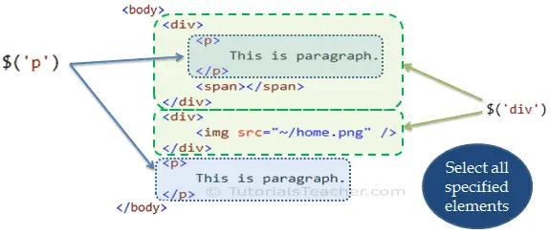
Select Elements by Name
The most common selector pattern is element name. Specifing an element name as string e.g. $(‘p’) will return an array of all the <p> elements in a webpage.
The following figure shows which DOM elements will be returned from $('p') & $'(div’).

Slide 33
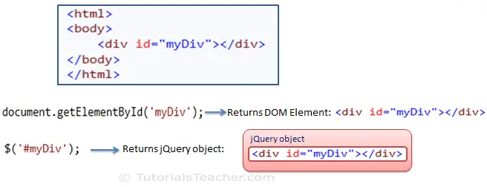
jQuery Methods
The jQuery selector finds particular DOM element(s) and wraps them with jQuery object. For example, document.getElementById() in the JavaScript will return DOM object whereas $('#id') will return jQuery object.

Slide 34
Manipulate HTML Attributes using jQuery
The following table lists jQuery methods to get or set value of attribute, property, text or html.
jQuery Method | Description
attr() | Get or set the value of specified attribute of the target element(s).
prop() | Get or set the value of specified property of the target element(s).
html() | Get or set html content to the specified target element(s).
text() | Get or set text for the specified target element(s).
val() | Get or set value property of the specified target element.

Slide 35
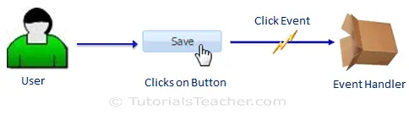
jQuery Events
In most web applications, the user does some action to perform an operation. For example, user clicks on save button to save the edited data in a web page. Here, clicking on the button is a user's action, which triggers click event and click event handler (function) saves data.

Slide 36
jQuery Event Methods
Category | jQuery Method | DOM Event
Form events | blur | onblur
 | change | onchange
 | focus | onfocus
 | focusin | onfocusin
 | select | onselect
 | submit | onsubmit
Keyboard events | keydown | onkeydown
 | keypress | onkeypress
 | keyup | onkeyup
 | focusout
Mouse events | click | onclick
 | dblclick | ondblclick

Slide 37
jQuery Event Methods(Continue…)
Category | jQuery Method | DOM Event
 | focusout
 | hover
 | mousedown | onmousedown
 | mouseenter | onmouseenter
 | mouseleave | onmouseleave
 | mousemove | onmousemove
 | mouseout | onmouseout
 | mouseover | onmouseover
 | mouseup | onmouseup
 | Toggle
Browser events | Error | onerror()
Category | jQuery Method | DOM Event
Resize | onresize
 | Scroll | onscroll
Document loading | Load | onload
 | Ready
 | Unload | onunload

Slide 38
jQuery Callback Functions
JavaScript statements are executed line by line. However, with effects, the next line of code can be run even though the effect is not finished. This can create errors.
To prevent this, you can create a callback function.
A callback function is executed after the current effect is finished.
Typical syntax: $(selector).hide(speed,callback);

Slide 39
jQuery - Chaining
With jQuery, you can chain together actions/methods.
Chaining allows us to run multiple jQuery methods (on the same element) within a single statement.
Query Method Chaining
Until now we have been writing jQuery statements one at a time (one after the other).
However, there is a technique called chaining, that allows us to run multiple jQuery commands, one after the other, on the same element(s).
Tip: This way, browsers do not have to find the same element(s) more than once.
To chain an action, you simply append the action to the previous action.

Slide 40
jQuery - Get Content and Attributes
Get Content - text(), html(), and val()
Three simple, but useful, jQuery methods for DOM manipulation are:
Text():Sets or returns the text content of selected elements
Html():Sets or returns the content of selected elements (including HTML markup)
Val():Sets or returns the value of form fields

Slide 41
AJAX

Slide 42
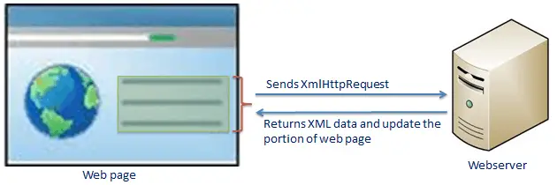
AJAX Introduction
AJAX stands for "Asynchronous JavaScript and XML". JavaScript includes features of sending asynchronous http request using XMLHttpRequest object. Ajax is about using this ability of JavaScript to send asynchronous http request and get the xml data as a response (also in other formats) and update the part of a web page (using JavaScript) without reloading or refreshing entire web page.
The following Figure Illustrates the Ajax Functionality

Slide 43
AJAX Example
<!DOCTYPE html> <html> <body> <div id="demo"> <h2>Let AJAX change this text</h2> <button type="button" onclick="loadDoc()">Change Content</button> </div> </body> </html>
function loadDoc() { var xhttp = new XMLHttpRequest(); xhttp.onreadystatechange = function() { if (this.readyState == 4 && this.status == 200) { document.getElementById("demo").innerHTML = this.responseText; } }; xhttp.open("GET", "ajax_info.txt", true); xhttp.send(); }

Slide 44
The XMLHttpRequest Object
The XMLHttpRequest Object
All modern browsers support the XMLHttpRequest object.
The XMLHttpRequest object can be used to exchange data with a server behind the scenes. This means that it is possible to update parts of a web page, without reloading the whole page.
Create an XMLHttpRequest Object
All modern browsers (Chrome, Firefox, Edge (and IE7+), Safari, Opera) have a built-in XMLHttpRequest object.
Syntax for creating an XMLHttpRequest object:
variable = new XMLHttpRequest();

Slide 45
XMLHttpRequest Object Properties
Property | Description
onreadystatechange | Defines a function to be called when the readyState property changes
readyState | Holds the status of the XMLHttpRequest. 0: request not initialized 1: server connection established 2: request received 3: processing request 4: request finished and response is ready
responseText | Returns the response data as a string
responseXML | Returns the response data as XML data
status | Returns the status-number of a request 200: "OK" 403: "Forbidden" 404: "Not Found" For a complete list go to the Http Messages Reference
statusText | Returns the status-text (e.g. "OK" or "Not Found")

Slide 46
Access Across Domains
For security reasons, modern browsers do not allow access across domains.
This means that both the web page and the XML file it tries to load, must be located on the same server.
XMLHttpRequest Object Methods
Method | Description
new XMLHttpRequest() | Creates a new XMLHttpRequest object
abort() | Cancels the current request
getAllResponseHeaders() | Returns header information
getResponseHeader() | Returns specific header information
open(method,url,async,user,psw) | Specifies the request method: the request type GET or POST url: the file location async: true (asynchronous) or false (synchronous) user: optional user name psw: optional password
send() | Sends the request to the server Used for GET requests
send(string) | Sends the request to the server. Used for POST requests
setRequestHeader() | Adds a label/value pair to the header to be sent

Slide 47
jQuery ajax() Method
The jQuery ajax() method provides core functionality of Ajax in jQuery. It sends asynchronous HTTP requests to the server.
Syntax:
$.ajax(url);
$.ajax(url,[options]);
Parameter description:
url: A string URL to which you want to submit or retrieve the data
options: Configuration options for Ajax request. An options parameter can be specified using JSON format. This parameter is optional.

Slide 48
GET or POST?
GET is simpler and faster than POST, and can be used in most cases.
However, always use POST requests when:
A cached file is not an option (update a file or database on the server).
Sending a large amount of data to the server (POST has no size limitations).
Sending user input (which can contain unknown characters), POST is more robust and secure than GET.

Slide 49
jQuery get() Method
The jQuery get() method sends asynchronous http GET request to the server and retrieves the data.
Syntax
Parameters Description:
url: request url from which you want to retrieve the data
data: data to be sent to the server with the request as a query string
callback: function to be executed when request succeeds
The following example shows how to retrieve data from a text file.
jQuery get() Method
$.get(url, [data],[callback]);
$.get('/data.txt', // url
function (data, textStatus, jqXHR) {
// success callback alert('status: ' + textStatus + ', data:' + data); });

Slide 50
jQuery post() Method
The jQuery post() method sends asynchronous http POST request to the server to submit the data to the server and get the response.
Syntax
Parameter Description:
url: request url from which you want to submit & retrieve the data.
data: json data to be sent to the server with request as a form data.
callback: function to be executed when request succeeds.
type: data type of the response content.
submit JSON Data using post() Method
$.post(url,[data],[callback],[type]);
$.post('/submitJSONData', // url
{ myData: 'This is my data.' }, // data to be submit
function(data, status, xhr) { // success callback function
alert('status: ' + status + ', data: ' + data.responseData); }, 'json'); // response data format

Slide 51
jQuery load() Method
The jQuery load() method allows HTML or text content to be loaded from a server and added into a DOM element.
Syntax
Parameters Description:
url: request url from which you want to retrieve the content
data: JSON data to be sent with request to the server.
callback: function to be executed when request succeeds
Load HTML Content
$.load(url,[data],[callback]);
$('#msgDiv').load('/demo.html'); <div id="msgDiv"></div>

